Slide 1
Evaluating Machine Learning Classifiers: Accuracy, Precision and Recall
Scott O’Hara
Metrowest Developers Machine Learning Group
07/25/2018

Slide 2
References
Applied Machine Learning in Python
University of Michigan, Prof. Kevin Collins Thompson (AMLP)
https://www.coursera.org/learn/python-machine-learning/home/welcome
Machine Learning: Classification
University of Washington, Profs. Emily Fox & Carlos Guestrin (MLC)
https://www.coursera.org/learn/ml-regression/home/welcome

Slide 3
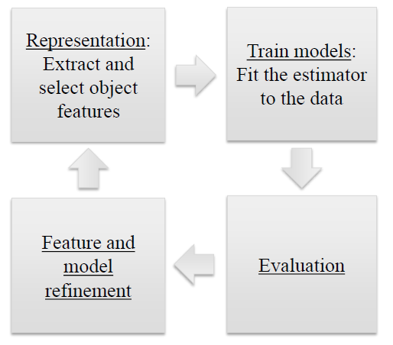
Represent, Train, Evaluate, Refine
AMLP

Slide 4





What Criteria Should we use to evaluate our Models?
AMLP

Slide 5

Accuracy is a Common Metric
$$Accuracy= \frac{\# of correct predictions}{\# of total instances}$$
A model with 99.9% accuracy can sound really good!
AMLP

Slide 6
HOWEVER, Consider Imbalanced Classes
Suppose you have two classes:
Relevant (R): the positive class
Not_Relevant (N): the negative class
Out of 1000 randomly selected items, on average
1 item is relevant
999 items are not relevant
AMLP

Slide 7

A Dummy Classifier gets 99.9% Accuracy!
Classifier always predicts N
Out of 1000 randomly selected items:
$$Accuracy= \frac{999}{1000}=99.9\%$$
AMLP

Slide 8
Dummy classifiers
typically ignore training data features.
often make predictions based on the distribution of the training data labels.
can serve as a sanity check on your classifier’s performance.

Slide 9
Common Dummy classifiers
most-frequent: predict most frequent label in training set.
stratified: random prediction based on training set distribution
uniform: choose predictions from a uniform distribution.
constant: predict constant label given by user.
AMLP

Slide 10
Evaluation
Different applications have different goals
Accuracy is widely used, but many other metrics are possible, e.g.,
- User satisfaction (Web search)
- Amount of revenue (e-commerce)
- Increase in patient survival rates (medical)
AMLP

Slide 11
precision and recall
Two common alternatives to accuracy are: precision and recall.
PRECISION: fraction of positive predictions that are actually positive.
RECALL: fraction of positive examples that are predicted to be position
AMLP

Slide 12
domains where precision is important
Search engine rankings, query suggestions
Document classification
Customer-facing tasks, e.g.,:
product recommendation
a restaurant website that automatically selects and posts positive reviews.
AMLP

Slide 13
domains where RECALL is important
Cancer tumor detection
Search and information extraction in legal discovery.
Often paired with a human expert to filter out false positives
AMLP

Slide 14
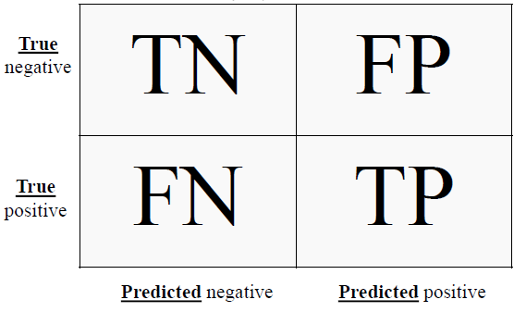
The Confusion Matrix
TP = true positive
FP = false positive
TN = true negative
FN = false negative
AMLP

Slide 15
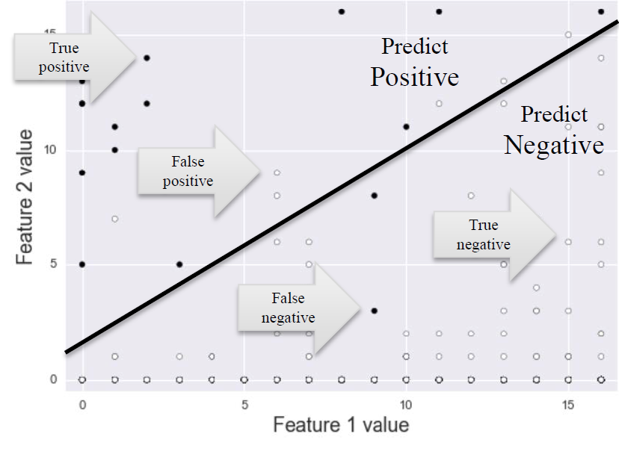
Visualizing different Error Types
AMLP

Slide 16
The Confusion Matrix
Every test instance is in exactly one box.
Breaks down classifier results by error type (TP vs TN vs FP vs FN).
Provides more information than simple accuracy.
Helps you choose an evaluation metric that matches your project goals.
There are many possible metrics that can be derived from the confusion matrix.
= 356
= 51
= 38
= 5
N = TN+TP+FN+FP = 450
AMLP

Slide 17
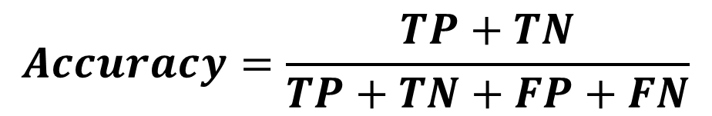




Accuracy
As FN + FP → 0, Accuracy → 1.0
As FN + FP ↑, Accuracy → 0.0
$$Accuracy=\frac{TP+TN}{TP+TN+FP+FN}$$
AMLP

Slide 18


precision
As FP → 0, Precision → 1.0
As FP ↑, Precision → 0.0
$$Precision=\frac{TP}{TP+FP}$$
AMLP

Slide 19


RECALL
As FN → 0, Recall → 1.0
As FN ↑, Recall → 0.0
$$Recall=\frac{TP}{TP+FN}$$
AMLP

Slide 20
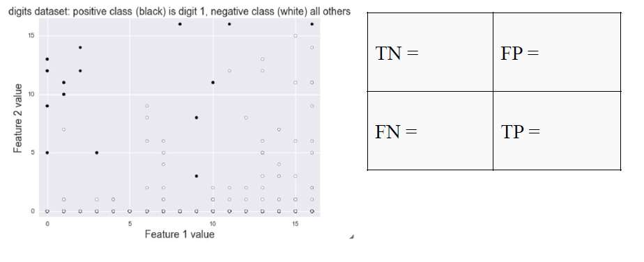
Illustrating Precision & Recall
AMLP

Slide 21
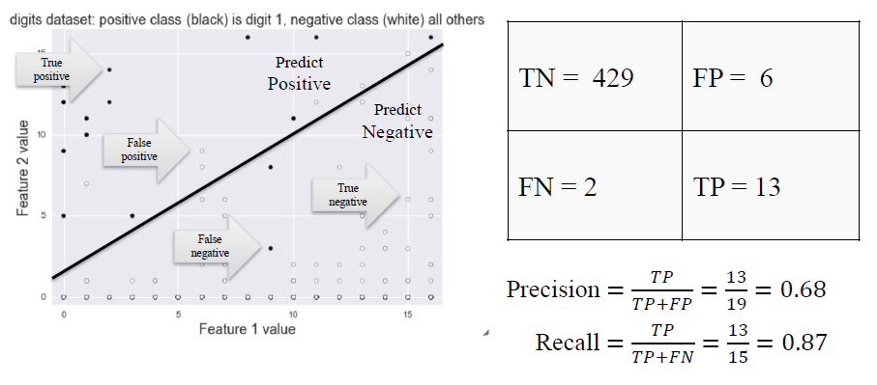
Illustrating Precision & Recall
AMLP

Slide 22
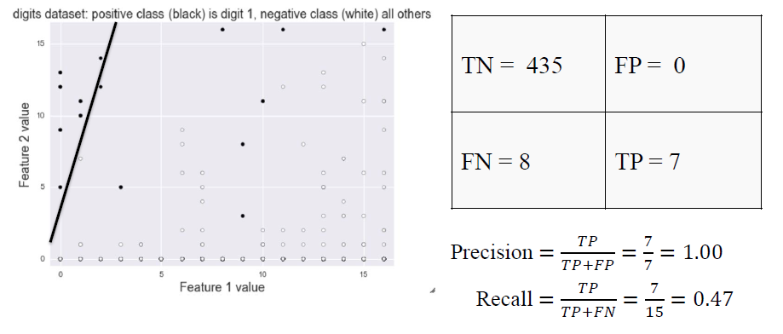

High precision / low recall
AMLP

Slide 23
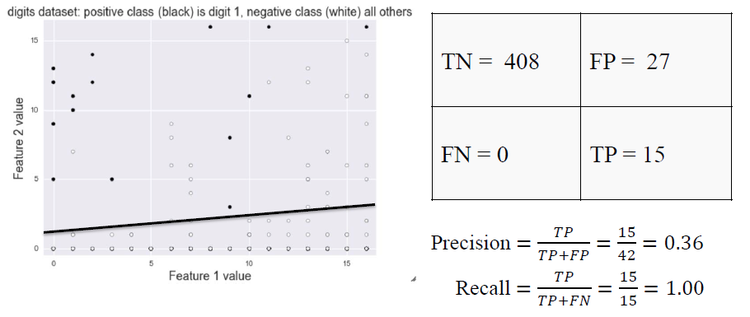

High RECALL / low Precision
AMLP

Slide 24
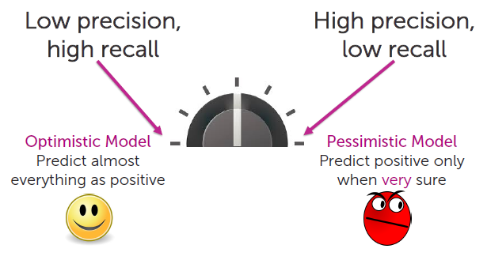
Balancing Precision and recall
Rather than seeking to maximize precision or recall, an optimal balance between the two is often sought.
MLC

Slide 25

The F1-score
The F1-score combines precision and recall into a single number.
The F1-score is the harmonic mean of precision and recall.
AMLP

Slide 26
The F-score
The F-score is a generalization of the F1-score.
β allows adjustment of the metric to control the emphasis on recall vs precision.
β < 1.0 results in greater precision (minimize false positives)
β > 1.0 results in greater recall (minimize false negatives)
AMLP

Slide 27
Decision Functions
Any classifier that returns a score that represents how confident the classifier is in its prediction can be “adjusted” to result in a decision function that exhibits more or less precision or recall.
By sweeping the decision threshold through the entire range of possible score values, we get a series of classification outcomes that form a curve.
AMLP

Slide 28
Probabilistic classifiers
Some classifiers return a probability that an item is a particular class rather than a Boolean value.
Decision functions can be constructed from probabilistic classifier.
Examples include Logistic regression, Naïve Bayes.
Typical rule is choose likely class if P(x) > threshold where threshold = 0.5
Adjusting threshold affects predictions of classifier
A higher threshold results in a more “pessimistic” classifier i.e., it increase precision.
A lower threshold results in a more “optimistic” classifier i.e., it increases recall.
AMLP

Slide 29
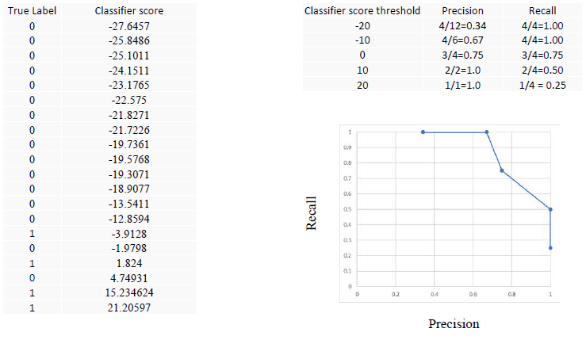
Varying the Decision Threshold
AMLP

Slide 30
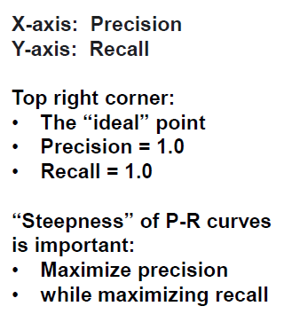
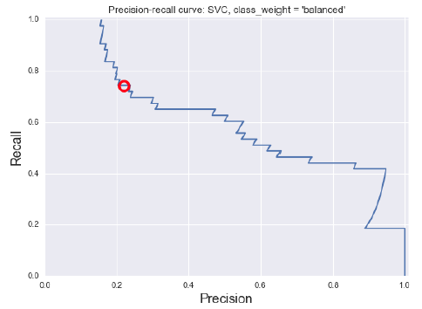
Precision-recall curves
AMLP

Slide 31
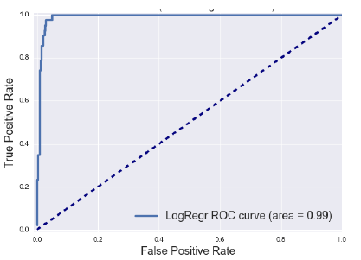
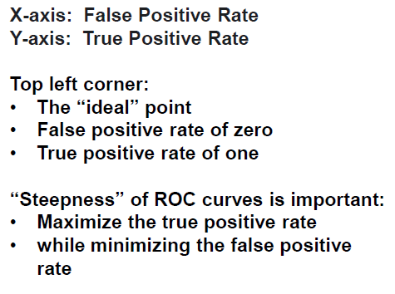
ROC Curves
ROC = Receiver Operating Characteristic
AMLP

Slide 32
ROC Curves: Random guessing
AMLP

Slide 33
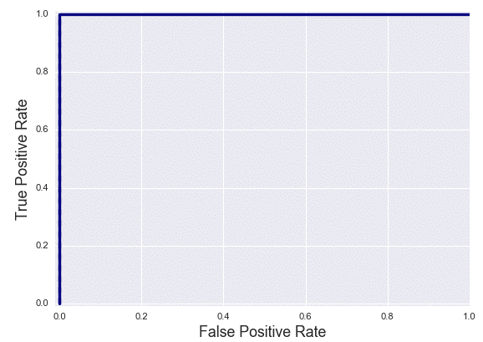
ROC Curves: perfect classifier
AMLP

Slide 34
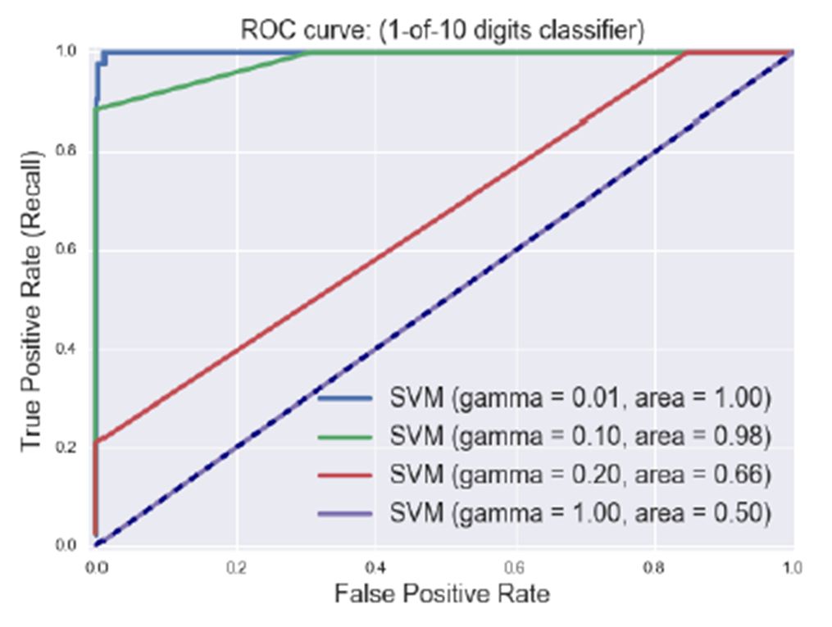
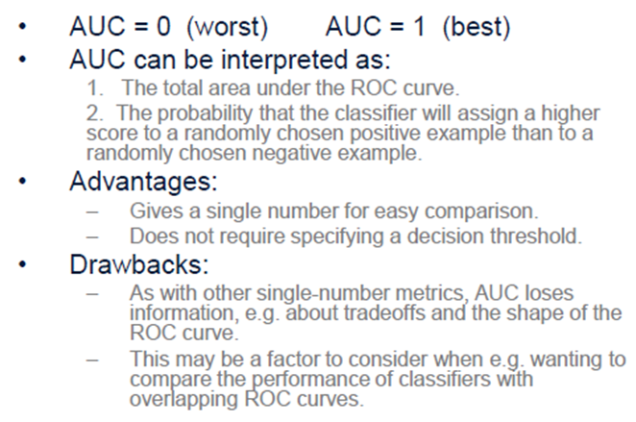
Summarizing an ROC curve in one number: Area Under the Curve (AUC)
AMLP

Slide 35
Conclusion
Accuracy is often not the right evaluation metric for many real-world machine learning tasks
False positives and false negatives sometimes need to be treated very differently
Make sure you understand the needs of your application and choose an evaluation metric that matches your application, user, or business goals.
AMLP

Slide 36
A general Approach
Consider carefully the data you have and what you are trying to do with it.
Choose a SINGLE metric and optimize that metric.
If this gives satisfactory results, then you are done. Otherwise return to step 1.

Slide 37
Other evaluation methods
Learning curve: How much does accuracy (or other metric) change as a function of the amount of training data?
Sensitivity analysis: How much does accuracy (or other metric) change as a function of key learning parameter values?
AMLP

